Slide 1
Lecture 2 – Ethics
Michael Bailey
University of Illinois
ECE 422/CS 461 – Fall 2015

Slide 2
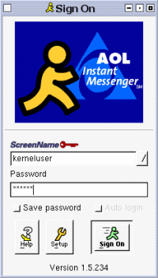
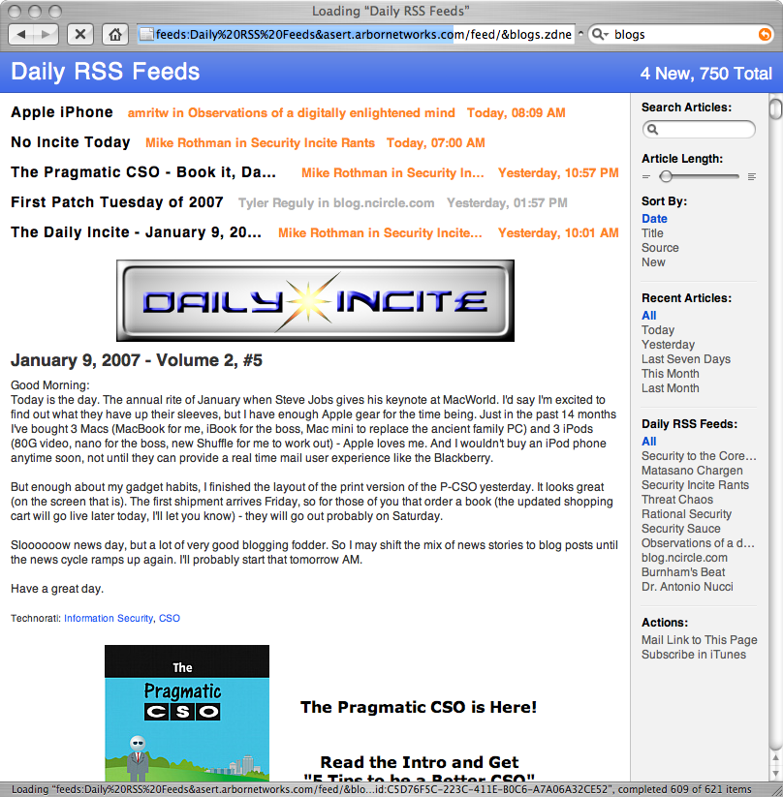
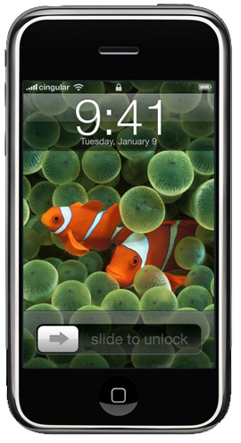

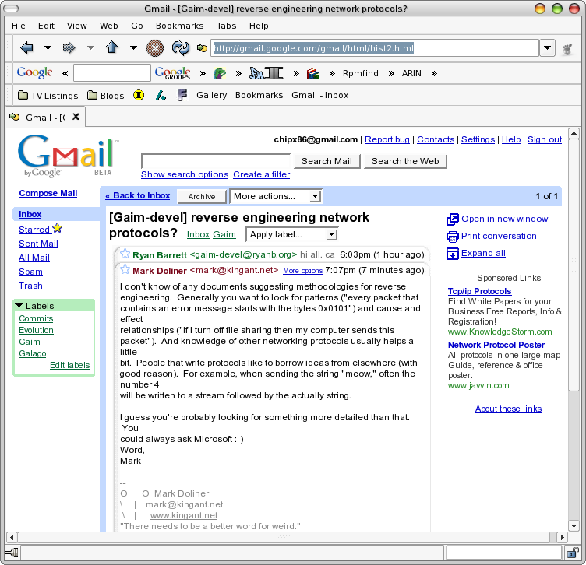
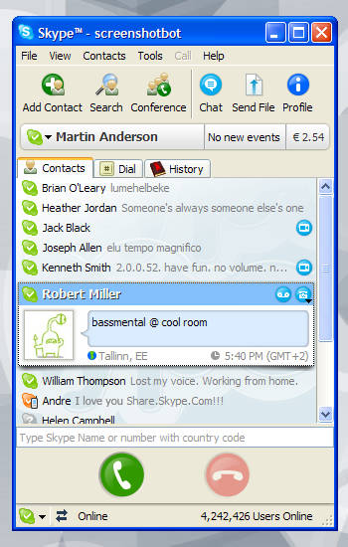
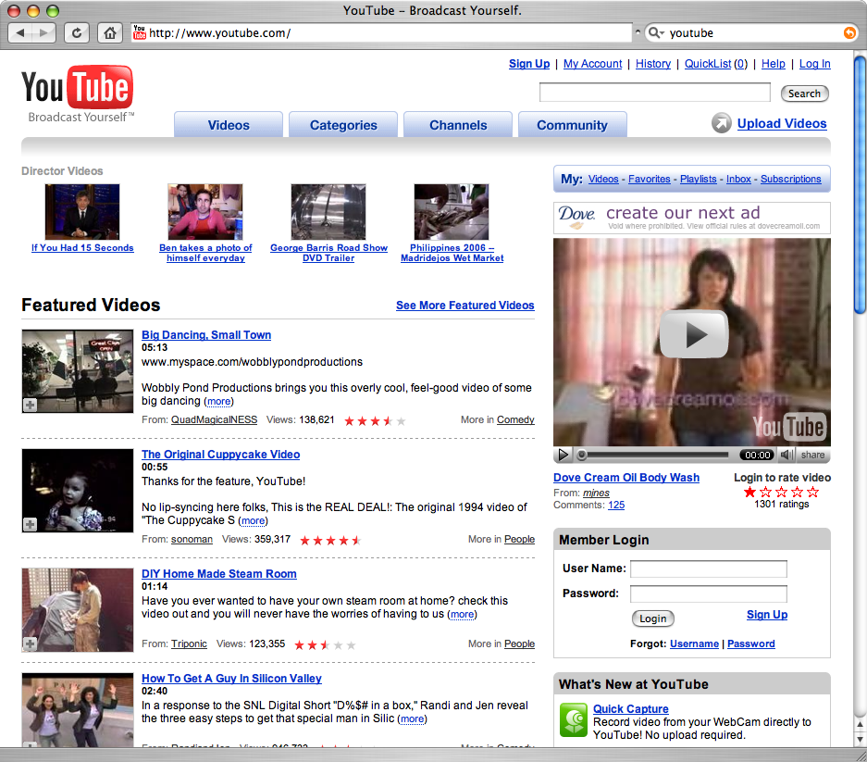
In an increasingly networked society…
2008
1988
Remarkable
Pace of innovation
IM
BLOGS
MOBILE
EMAIL
VIDEO
VOIP
Notes:
People all over the world are now participating in an astonishing variety of collective, distributed tasks, not merely to contribute information about themselves and their interests, but to participate in broader collective causes, such as labeling digital images according to their perceived content (images.google.com/imagelabeler), online games that contribute to protein design (foldit), classifying galaxies in astronomical images (galaxyzoo.org), labeling stories, etc. The people who provide wikipedia entries and fold proteins are doing it quite intentionally and spending significant time doing it. Many people rating their Netflix movies or shopping at Amazon may be unaware the WWW sites are capturing information derived from their actions. (E.g., the sinister: We know everything about you.)
This is just the beginning of a new field of collective intelligence in which modern technology yields new understanding of collective human behavior and new methods for problem-solving in complex systems and networks. We have many terms for describing what people do and the technologies they use. Here are some examples. The users and their activities include clickworkers, participatory journalism, the genius in the crowd, and the wisdom of the crowds. The technologies include collaborative filtering, recommender systems, reputation systems, and auctions. Outcomes include swarm intelligence, human-based computation, and digital or e-societies.
The label we are putting on all this is Network Society. We have barely scratched the surface in understanding these phenomenon.
---------
Some of the pictures:
Maplight.org = non=partisan research org tracking money and politics in congress
EsP Game addresses the problem of difficult metadata on images → a game
Innocentive = matching problems and problem solvers
Match.com = someone you love is neary by
Iowa Electronic markets = real money futures market; research in economics
4 colors suffice= how the map color problem was solved
Global search challenge = most promising security startups

Slide 3
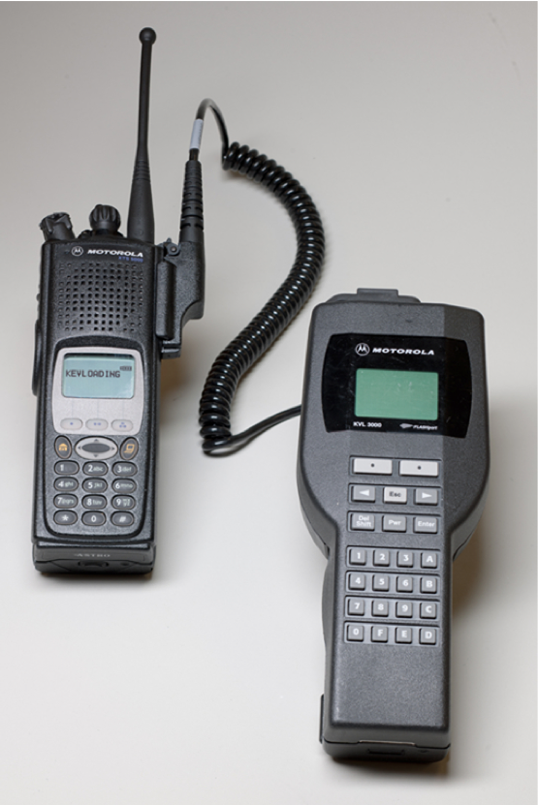
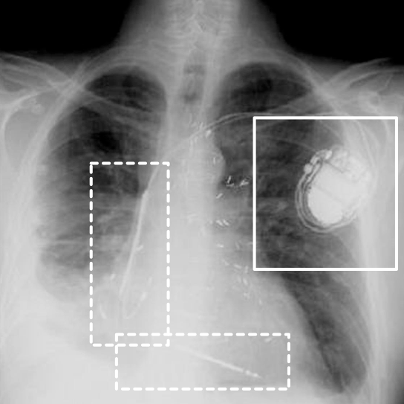
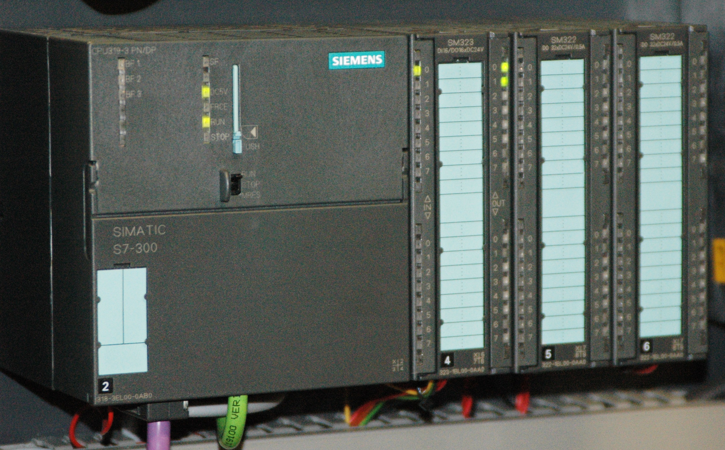
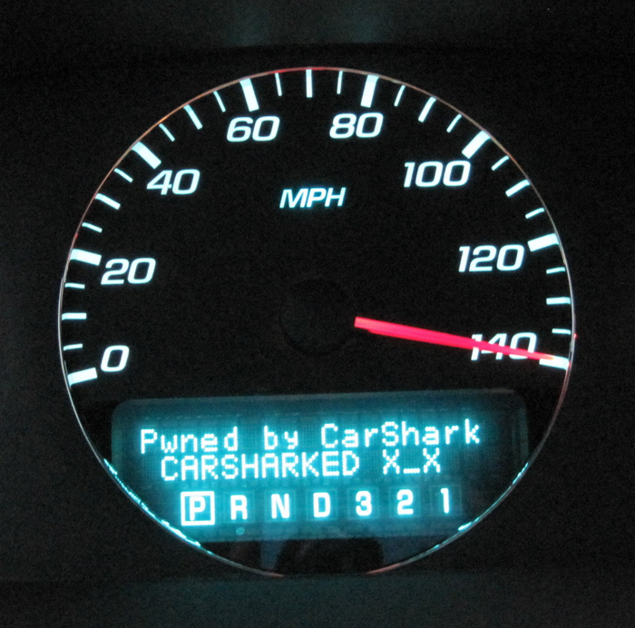
… where computers are in everything
Law Enforcement Communications
Embedded Medical Devices
Automobiles
Control Systems
Notes:
Each sector that becomes cyber-enabled becomes vulnerable to attack. Healthcare, education, and finance are already at risk, and physical infrastructure –manufacturing, energy production, and transportation – will be next. This trend toward increasingly cyber-physical systems, the integration of computation, communication, and control into physical systems, will continue to offer new challenges. Consider, for example, the recent STUXNET worm. Discovered in July 2010, this worm targeted SCADA systems that were configured to monitor and control a kind of centrifuge used in Iranian nuclear fuel processing facilities.

Slide 4
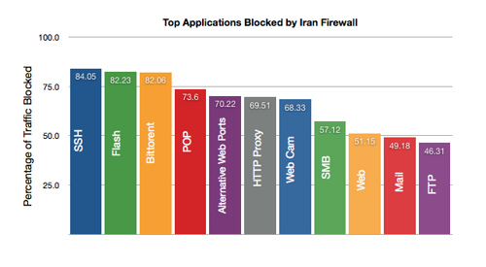
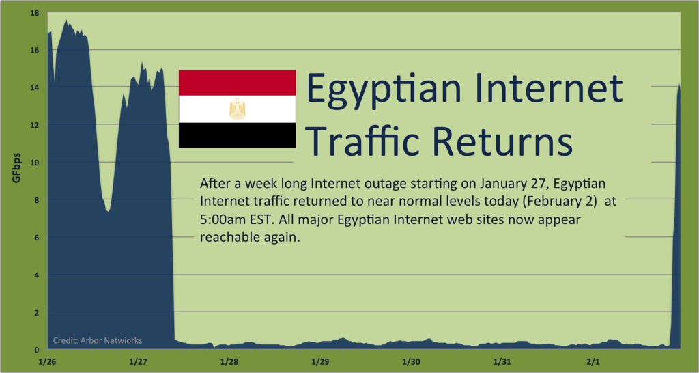
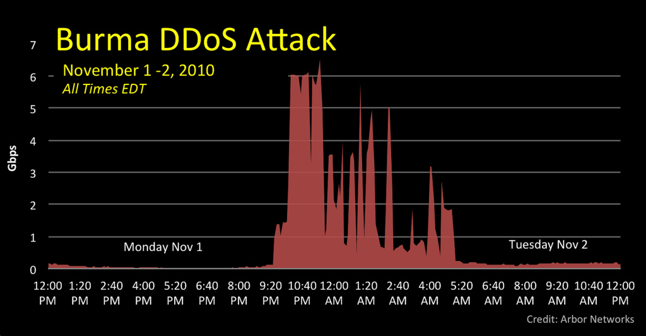
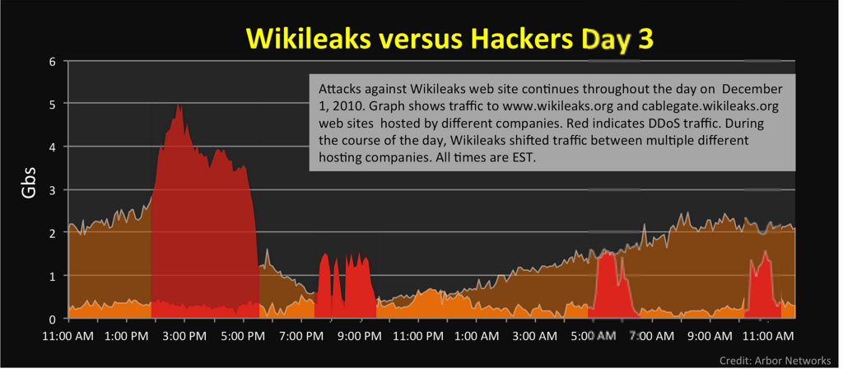
… where simply turning off the Internet can change the face of democracy
Top Applications Blocked by Iran Firewall
Notes:
The economic factors influencing threats in the early emergence of botnets were just the tip of the iceberg. As the Internet continued to be become more and more intertwined in the economic, political, and social fabric of our societies, the debate around free and open access to the Internet grew. The limiting of this free and open access for moral, political, or economic reasons, is ultimately a societal challenge, but the globally interconnected nature of our networks, such decisions impact not only our global aspiration, but the security and availability of our networks.

Slide 5

Thank goodness for the security researchers

Slide 6
Security “Research” to the Rescue!
Researchers want to help, to benefit the internet community
…but oh, the temptations!
First to publish; do something new; show how 31337 you are; fight for funding; ends justify the means
…and the conflicts
Affecting other research; impacting LE investigations; thwarting mitigation efforts; protecting rights; helping the bad guys; less risky (and less sexy) options?

Slide 7

Security “Research” to the Rescue!
Researchers want to help, to benefit the internet community
…but oh, the temptations!
First to publish; do something new; show how 31337 you are; fight for funding; ends justify the means
…and the conflicts
Affecting other research; impacting LE investigations; thwarting mitigation efforts; protecting rights; helping the bad guys; less risky (and less sexy) options?
Who Cares ?

Slide 8

Don’t get caught playing …

Slide 9
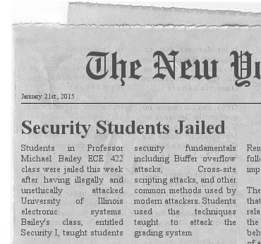
There is gonna be an epic fail

Slide 10
What are ethics?
“The field of ethics (or moral philosophy) involves systematizing, defending, and recommending concepts of right and wrong behavior.”
Normative ethics, is concerned with developing a set of morals or guiding principles intended to influence the conduct of individuals and groups within a population (i.e., a profession, a religion, or society at large).
Consequentialism
Deontology
virtue ethics

Slide 11
Computer Ethics
“A typical problem in computer ethics arises because there is a policy vacuum about how computer technology should be used. Computers provide us with new capabilities and these in turn give us new choices for action. Often, either no policies for conduct in these situations exist or existing policies seem inadequate. A central task of computer ethics is to determine what we should do in such cases, i.e., to formulate policies to guide our actions.”
-Moor

Slide 12
Ethics != Law
“Law can be defined as a consistent set of universal rules that are widely published, generally accepted, and usually enforced”
Interrelated but by no means identical (e.g., legal but not ethical, ethical but not legal)
Adherence to ethical principles may be required to meet regulatory requirements surrounding academic research
A law may illuminate the line between beneficial acts and harmful ones.
If the computer security research community develops ethical principals and standards that are acceptable to the profession and integrates those as standard practice, it makes it easier for legislatures and courts to effectively perform their functions.

Slide 13
IANAL
CFAA (18 usc 1030)
Computer Trespass
Electronic Communications
Wire And Electronic Communications Interception And Interception of Oral Communications
Electronic Communications Privacy Act (ECPA)
Providers may carry data for a variety of institutions such as hospitals, libraries, universities, and K-12 organizations
Family Educational Right to Privacy Act (FERPA)
Federal Standards for Privacy of Individually Identifiable Health Information (implements the privacy requirements HIPAA)
UIUC Policy Documents
the Campus Administrative Manual (especially Policy on Appropriate Use of Computers and Network Systems at the University of Illinois at Urbana-Champaign)
Student Code (especially 1-302 Rules of Conduct, 1‑402 Academic Integrity Infractions.

Slide 14
Existing Ethics Standards
1947 Nuremberg Code
Helsinki Declaration 1964
The IEEE, ACM, etc: Codes of Ethics
The Belmont Report, the National Research Act, and Institutional Review Boards (IRB)
45 CFR 46
“Rules of Engagement”
The Law of Armed Conflict
Dittrich/Himma: Active Response Continuum
Other Organizational Codes (Universities, Corporations, etc.)

Slide 15
IRB and the Belmont report
The primary goal of the Institutional Review Board (IRB) is to assure that, in research involving human subjects, the rights and welfare of the subjects are adequately protected.
"Ethical Principles and Guidelines for the Protection of Human Subjects of Research”, United States Department of Health, Education, and Welfare, April 18, 1979 (Belmont Report)
Respect for persons
Individuals should be treated autonomously
Informed consent should be freely given
Beneficence
Do no harm
Maximize possible benefits/minimize risks
Distributive Justice
Equitable selection of research subjects

Slide 16
Professional Ethical Codes
IEEE Code of Ethics (2006)
commits members ”to the highest ethical and professional conduct”. Members agree to avoid conflicts of interest, be honest, engage in responsible decision making, accept criticism of work, etc
ACM Code of Ethics and Professional conduct (1992)
“contribute to society and human well-being”, “avoid harm to others”, along with six other principles (e.g., don’t discriminate, be honest, respect privacy).

Slide 17

Class dismissed, let’s get a beer.

Slide 18


Slide 19
The Case Study
Researchers at a U.S. university begin a comprehensive study of botnet behavior with the goal of understanding the technical, economic, and social factors that underlie botnet propagation, control, and use.

Slide 20

"Ladies and gentlemen: the story you are about to hear is true. Only the names have been changed to protect the innocent."

Slide 21
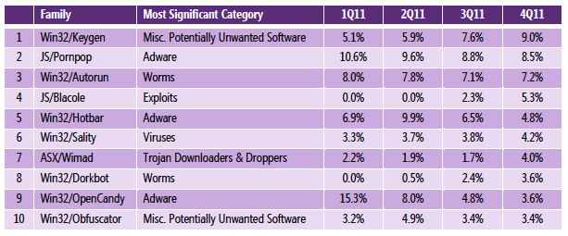
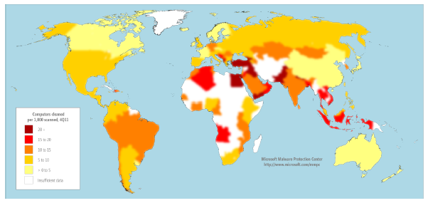
The Botnet Threat
Botnets represent today’s attack platform
DoS Extortion, Identity Theft, Phishing, SPAM, Spyware
Microsoft desktop anti-malware products removed bots from 6.5 million computers around the world in 2Q10 [Microsoft SIR v9]
Notes:
After worms, global Internet threats underwent a profound transformation from attacks designed solely to disable infrastructure to those that also target people and organizations. This alarming new class of attacks directly impacts the day-to-day lives of millions of people and endangers businesses and governments around the world. For example, computer users are assailed with spyware that snoops on confidential information, spam that floods email accounts, and phishing scams that steal identities.
At the center of many of these attacks is a large pool of compromised computers located in homes, schools, businesses, and governments around the world. Attackers use these zombies as anonymous proxies to hide their real identities and amplify their attacks. Bot software enables an operator to remotely control each system and group them together to form what is commonly referred to as a zombie army or botnet. The magnitude of the problem is tremendous—Microsoft desktop anti-malware products removed bots from 6.5 million computers around the world in 2Q10

Slide 22
What’s a “bot”?
A bot is a servant process on a compromised system
Usually installed by a trojan, though worms have evolved to install bots as well (e.g., deloder)
Communicates with a handler or controller (e.g., using IRC, often running on public IRC servers or other compromised systems)
Almost always unbeknownst to the systems owner - ‘got bot?’
A botmaster or botherder commands bots to perform any of an array of different functions
System of bots and controller(s) is referred to as a botnet or zombie network

Slide 23
The Botnet
UK Broadband
JP Corp
B
B
Provider
Internet
Backbone
The
Peaceful
Village
B
B
US Corp
US Broadband

Slide 24
The Botnet
UK Broadband
JP Corp
B
B
Provider
Internet
Backbone
Systems
Become
Infected
B
B
US Corp
US Broadband

Slide 25
The Botnet
UK Broadband
JP Corp
B
B
Provider
P
Internet
Backbone
Bots form
an overlay
= botnet
B
B
US Corp
US Broadband

Slide 26
The Botnet
UK Broadband
JP Corp
B
B
Provider
P
Internet
Backbone
Controller
Connects
C
B
B
US Corp
US Broadband

Slide 27
The Botnet
UK Broadband
JP Corp
B
B
Provider
P
Internet
Backbone
Attack
Command
C
B
B
US Corp
US Broadband

Slide 28
1. The researchers create a botnet research testbed, connected to the Internet, which enables testbed machines to become infected.

Slide 29
2. The researchers selectively allow SPAM and other outbound traffic to assure botnet operators they are not being watched.
Notes:
Experiences collecting and analyzing these samples indicate that attackers test their environments to determine if they are being watched. Often these tests require the infected host to perform some malicious activity (e.g., send spam, infect another host) before downloading new versions of itself or actively participating in the botnet. The researchers construct an environment is which some of these Malicious behaviors are allowed and others are disallowed.

Slide 30
3. The researchers create an active component of their testbed which pulls malicious content (e.g., by visiting web sites and infecting browsers, from peer-to-peer networks).
Notes:
Further experiences show that simply running vulnerable services is insufficient to collect representative infections. The researchers create an active component of their testbed which pulls malicious content (e.g., by visiting web sites and infecting browsers, from peer-to-peer networks).

Slide 31
4. The researchers redirect user queries for known malicious sites to a benign server they control and monitor.
Notes:
The researchers note that many of the links and sites require the user to intervene in order to perform the action that results in the infection. Noting that users may be reluctant to visit harmful sites in a controlled environment, the researchers propose to observe this user behavior unbeknownst to the end users. In order to accomplish this, the researchers create an experiment in which they redirect user queries for known malicious sites to a benign server they control and monitor.

Slide 32
5. The researchers observe the active command and control channel of their infected bot.
Notes:
One allowed activity on the testbed is connection to a command and control server for the botnet, where commands are issued by the attacker to the botnet. By watching this channel the researchers are aware of a (subset) of the commands issued by the attacker to their infected machine. This includes instances in which bots are instructed to spam, denial of service attack, or propagate to other hosts.

Slide 33
6. The researchers monitor a command and control server within their network.
Notes:
During one such investigation, the researchers come to understand that their university hosts the command and control server for the botnet they are monitoring. They obtain, through their university, access to this command and control server. The researchers monitor this server to determine botnet membership and observe how various portions of the botnet are controlled.

Slide 34
7. The researchers acquire from their infected host the password to the drop zone and analyze the stolen files.
Notes:
The researchers determine that the botnet collects files from users computers and places the files in a central location. The malware contains, in a plain text file, as part of its install the password login and location of this server. The researchers, using this information, are able to remotely login to this server and characterize the contents of all the files collected botnet-wide. These files include personal data as well as copyrighted materials.

Slide 35
8. The researchers crack the password and use it to analyze the dropzone and its files.
Notes:
A newer variant of this malware no longer makes this information easily accessible. In an effort to find access to future drop zones, the researchers discover several vulnerabilities in the botnet code. These vulnerabilities allow the researchers to circumvent the system put in place by the attacker and to continue to access to the drop zone.

Slide 36
9. Researchers clean up the botnet by enumerating the infected hosts, exploiting a vulnerability, and removing the infected code.
Notes:
The analysis of the code allows the researchers to hypothesize that it might be possible to clean up the botnet by enumerating the infected hosts, exploiting the vulnerability, and removing the infected code.

Slide 37
11. Researchers release copies of not only the malicious code captured, but also the recovered files and data to restricted communities of security researchers.
Notes:
To spur further botnet research and to validate the results in their publications, the researchers release copies of not only the malicious code captured, but also the recovered files and data to restricted communities of security researchers

Slide 38
12. Researchers create and public code for a new botnet that is less susceptible to analysis and take down.
Notes:
Analysis of this malware family shows a continuing trend toward sophistication in response to mitigation by the defenders of users. This prompts researchers to hypothesize on the future techniques that attackers might employ to avoid detection. The researchers suggest and publish several such, yet unwitnessed, improvements, including more resilient topologies for botnet construction, novel encryption mechanisms, and cloud-based services for creation and obfuscation of the malware.

Slide 39
Moving forward
In this class you will not be asked to do anything that is illegal, unethical, or against university policy, so maybe you shouldn’t …
Ask permission not forgiveness
Principle of least surprise

Slide 40
To Learn More …
David Dittrich, Michael Bailey, Sven Dietrich. Building an Active Computer Security Ethics Community.
Dittrich, David and Kenneally, Erin and Bailey, Michael, Applying Ethical Principles to Information and Communication Technology Research: A Companion to the Menlo Report
https://www.acm.org/about/code-of-ethics
http://www.ieee.org/about/corporate/governance/p7-8.html

Slide 41
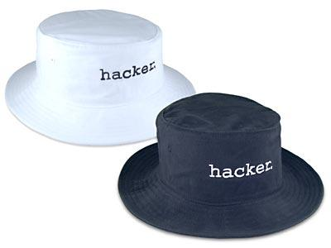
Questions?

